Slide 1
resQ
Quick Detection and Rescue of Trapped Victims in a Calamity
IOTHON 2.0
Satviki Das - 22BCT0363
Devansh Chopra - 22BCT0170
Ishan Dahiya - 22BCT0177

Slide 2
Table of Contents
Overview of the Problem and its Solution
Basic Working of the Device
Introduction to the Components
Working of the Device, Circuits and Codes
Business Model
Impact of the Solution
Conclusion

Slide 3
Overview
Problem:
When natural disasters or man-made calamities make buildings collapse, search and rescue teams immediately set out to find victims trapped beneath the debris. Time is imperative during these missions, and the ability to quickly detect living victims greatly boosts the odds of rescue and survival.
Solution:
To solve this problem we are going to make a device using arduino where we use RCWL-0516 doppler microwave radar sensor to detect movement through the debris composed of broken walls, metallic structures, furniture etc; and 433MHz transmit module will be placed on the arduino to relay information to the remote arduino that will have the receive module.

Slide 4
Basic working of the device
Our device consisting of an RCWL-0516 sensor and a 433MHz transmit module on an Arduino UNO will be sent to areas of distress using a drone.
And a remote device will be available to the rescue team with a recieve module placed on an Arduino board.
The RCWL-0516 sensor transmits microwaves and receives the reflected doppler waves and determines the movement through phase differences between them.
The transmit module will continuously relay this data to the remote Arduino which will be then interpreted to inform the rescue team that there are people present, by switching on an LED on the remote and informing the GPS location of that point.

Slide 5
RCWL - 0516
The RCWL-0516 sensor is a microwave motion sensor module that is primarily used to detect motion or movement in its proximity. It operates using microwave technology, specifically the Doppler effect, to detect changes in the reflection of microwave signals when an object or person moves within its detection range. When an object or person moves within its detection range, it detects the change in the frequency of the reflected signals due to the Doppler effect.

Slide 6
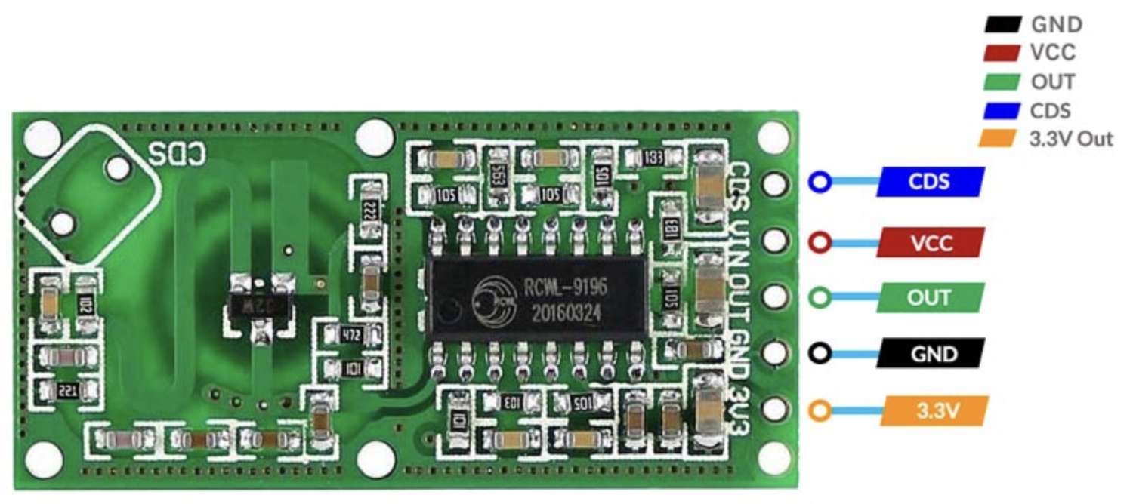
The RCWL 0516 module consists of an ASIC chip RCWL 9196 from RCWL. The RCWL 9196 comes in a 16-pin SOIC package. The module contains all the complimentary components along with a single transistor-based high-frequency oscillator which generates the microwave signal with a frequency of around 3.175GHz.
This module supports a wide input voltage, from 4 to 28 V DC, and is equipped with the RCWL-0516. It has a sensitive range of about 7 meters. When activated, its output pin (OUT) will transition from LOW (0V) to HIGH (3.3V) for a finite amount of time (2-3 seconds) before returning to sleep state (LOW).

Slide 7
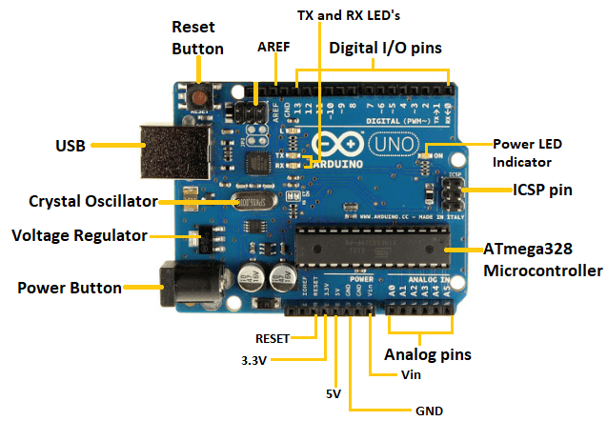
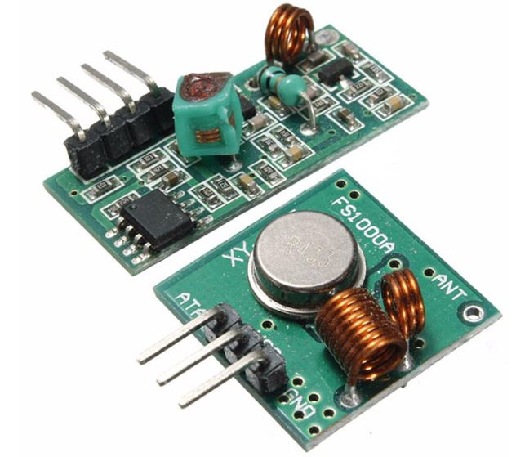
Arduino
Transmit & Receive Module
The Arduino Uno is a popular microcontroller board used for building electronic projects. It features an ATmega328P microcontroller, digital and analog pins for connecting sensors and actuators, and a USB interface for programming and power supply.
An Arduino board will be connected to a 433 MHz transmitter and will send the message. The other Arduino board will be connected to a 433 MHz receiver to receive the messages.

Slide 8
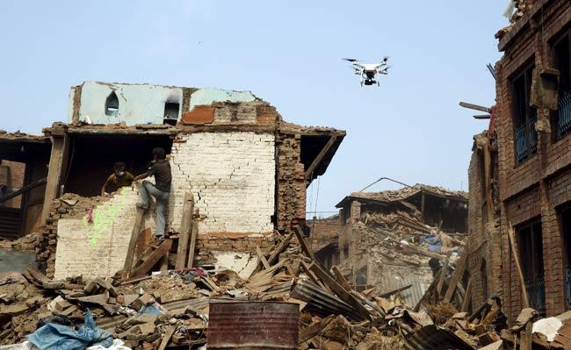
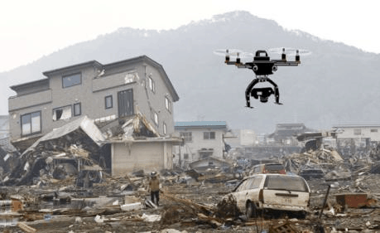
Movement Detector in Debris
A drone, with our transmitter device attached to it, is sent to an area of distress to detect living persons stuck under rubble and debris. On detection, the transmitter triggers the receiver device attached to the drone remote. From this information, paired with the GPS location of the drone (from the remote control of the drone) we can know the exact location of the victim.
In our project we will be building the the transmitter and receiver devices and code the functionality of the same.

Slide 9
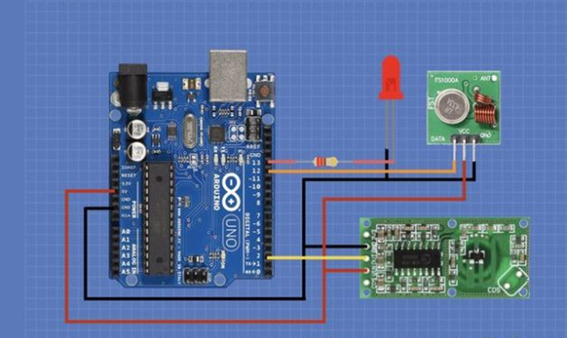
Transmitter Device
Components
Arduino Uno
RCWL-0516 Microwave Sensor
433MHz Transmitter Module
LED
220 ohm resistor
Wires
Connections
5V out pin of the Arduino is connected to the V in pin of the RCWL-0516.
Ground of the Arduino is connected to ground of RCWL-0516.
Out pin of RCWL-0516 connected to pin 2 of Arduino.
5V out pin of Arduino is connected to VCC of transmit module.
Ground of Arduino is connected to ground of transmit module.
Data out pin of transmit module is connected to pin 12 of Arduino.
Anode of LED is connected to one end of the resistor.
The other end of resistor is connected to pin 13 of Arduino.
Cathode of LED is connected to ground of the Arduino.

Slide 10
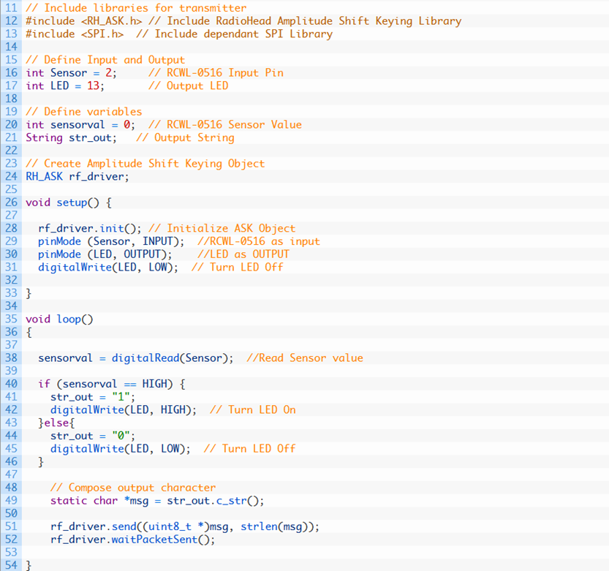
Transmitter Code
We will need to install the RADIOHEAD library and the SPI library to the Arduino IDE for the code to work.

Slide 11
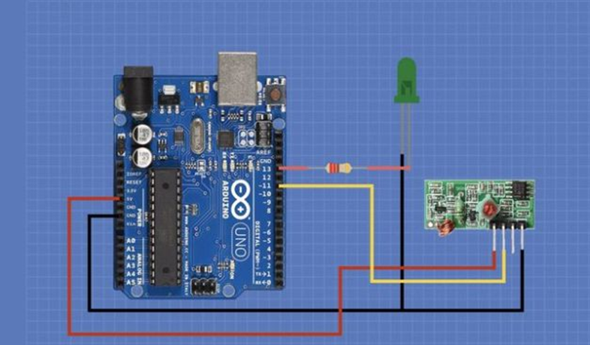
Receiver Device
Components
Arduino Uno
433MHz Receiver Module
LED
220 ohm resistor
Wires
Connections
5V out pin of Arduino is connected to VCC of receive module.
Ground of Arduino is connected to ground of receive module.
Data out pin of receive module is connected to pin 11 of Arduino.
Anode of LED is connected to one end of the resistor.
The other end of resistor is connected to pin 13 of Arduino.
Cathode of LED is connected to ground of the Arduino.

Slide 12
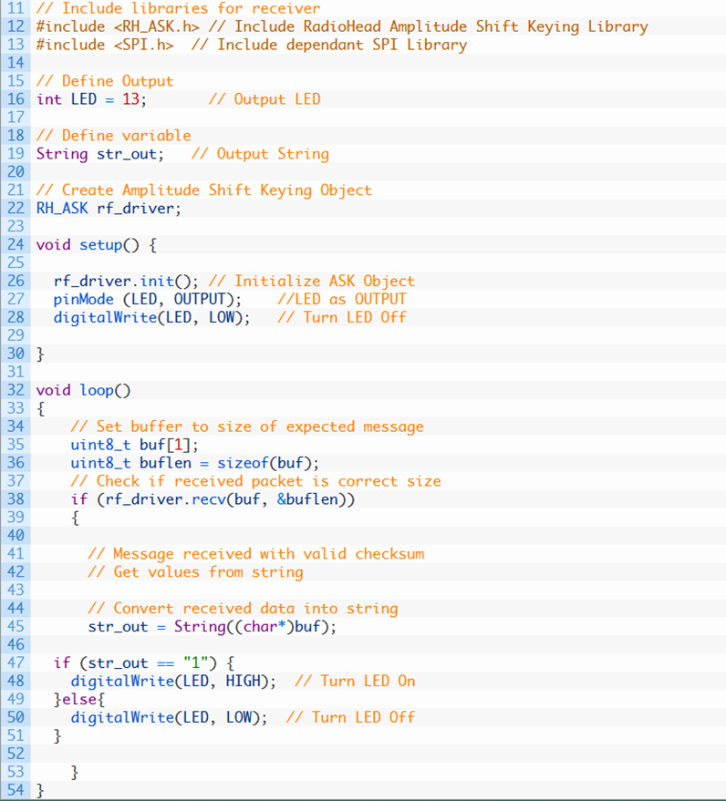
Receiver Code
We will need to install the RADIOHEAD library and the SPI library to the Arduino IDE for the code to work.

Slide 13
Business Model
Nonprofit or Social Enterprise Structure:
Consider structuring the organization as a nonprofit or social enterprise. This demonstrates a commitment to the humanitarian mission while allowing for revenue generation to sustain operations and expansion.
Funding Sources:
Seek grants, donations, and government contracts.
Charge user fees for technology and services.
Offer training, data analytics, and maintenance packages.
Partnerships and Collaboration:
Collaborate with humanitarian organizations, universities, research institutions, and technology partners to leverage resources, expertise, and innovation.

Slide 14
Maintenance and Support Contracts:
Offer ongoing maintenance and support contracts to ensure the technology remains operational and up-to-date. Recurring revenue can be generated through these contracts.
Transparency and Impact Reporting:
Maintain transparency in financial operations and impact reporting to demonstrate the technology's effectiveness in addressing humanitarian and disaster response challenges.
Ensure compliance with international regulations and ethical standards, especially regarding data privacy, security, and human rights in disaster-affected areas.

Slide 15
Impact of solution
The introduction and use of our equipment would have a significant impact on disaster and emergency response efforts. Here are some of the key impacts and implications of this technology:
01
Improved Survival Rates:
It would significantly improved the chances of finding and rescuing survivors in disaster situations.
02
Faster Response:
The device's real-time response to first responders allows them to quickly locate survivors, reduce response times, and ensure rapid delivery of medical care. This speed is important in situations where every minute counts, such as earthquakes or building collapses. By pinpointing the location of survivors, it helps minimize risk to rescue teams. This technology allows responders to focus their efforts on areas where survivors are detected, reducing the need for extensive and time-consuming searches.

Slide 16
03
Enhanced Safety for Rescuers:
The device's advanced algorithms are designed to distinguish between living individuals and inanimate objects or animals. This helps reduce false alarms and ensures resources are directed toward actual rescue efforts, increasing overall efficiency.
04
Reduced False Alarms:
It's ability to work on a variety of materials, including concrete and wood, makes it a versatile tool for various disaster situations. It can be used in urban environments, remote locations, and areas with harsh environmental conditions.
05
Versatility:
It can identify multiple victims within its field of vision, providing information on the number and general location of survivors. This capability allows responders to more accurately assess the scale of a disaster and allocate resources accordingly.

Slide 17
Conclusion
This technology will be primarily developed for humanitarian and disaster response purposes, with a focus on providing innovative solutions to save lives and improve disaster management. It incorporates cutting-edge features for rapid and non-invasive vital sign monitoring, ensuring timely and accurate detection of individuals in distress. Designed with portability, ease of use, and reliability in mind, it empowers first responders and disaster relief organizations to swiftly locate and aid victims, particularly in situations where traditional methods may be impractical or unsafe. This technology embodies a mission to enhance the effectiveness of emergency response efforts, making it an indispensable tool in safeguarding communities and minimizing the impact of disasters on vulnerable populations.

